Slide 1
Aim Technologies
Task

Slide 2
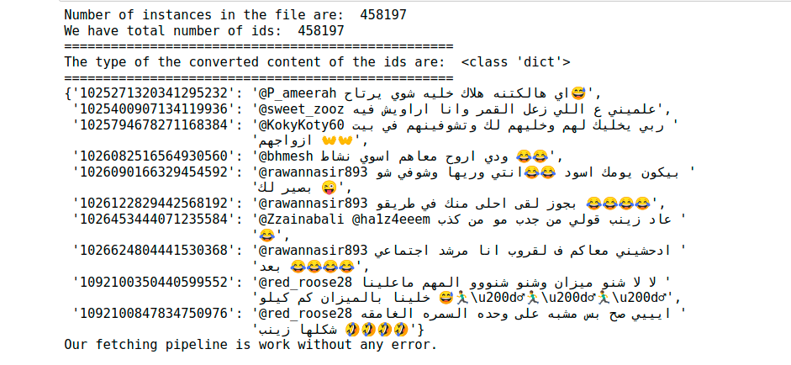
Data Fetching & Configs
Get ids as strings.
Make one list of these ids.
Passing 1000 ids by 1000 ids to the API as json request.
Display some ids associated with returned text as json dictionary.
Validate ids with returned data to ensure we have not missed ids.
There are helpful functions inside configs script or the main fetching script. Beside display the results in the Jupyter Notebook

Slide 3
Data Preprocessing & Suffling
Tweets are very rich of people opinion, and as each one represent his opinion in some ways, there are some common things in these tweets like "shared url", "emojis", "mentions" and other commons attalides.
Besides of that Arabic language has its own common things like dicrstics in text like(ً ُ), and others.
To come over of these problems we have design our pipeline of preprocessing either using some research work from AraVec, and some of our preprocessing.

Slide 4
Data Preprocessing
We have:
Replace url with Non-standard Arabic name.
Replace mentions with Non-standard Arabic name.
Remove TASHKEEL (Special chars for Arabic language).
Remove part of appeared special chars like /U000f and others.
Some special replacement and handle the other replacement.
Multiple emojis coming sequentially leave just one of them.
Separate numbers associated with words as well as English with Arabic words.
Remove char repeated more that two times sequentially.
Remove more spaces.
Some other preprocessing can be used like stemming or lemmatization, but we choose to leave every token as the same because of people represent their opinion on platforms like Twitter with no grammar conditions and others that the linguistics people use.

Slide 5
Shuffling & Data Preparation
There are different ways of shuffling the data, some of these ways are random and others are using statistical ways to distribute the variety of the data.
And as we are here dealing with classification problem to classify 18 different class, we need a way to split the data into training, validation and testing, but ensuring that we have approximate distribution across all classes as the same in the original data, at the same time do not miss any of these classes in the splitting.
Once we have the splitting data into training and testing, we also split training data also to split into training and validation, then start to extract features from that sata.
The data at hand are textual data so we need first to extract features (numbers), that the model can dealing with.
These features should be something that represent your text.

Slide 6
Shuffling & Data Preparation
The approach of features extraction we have used is the word representation that was introduced in 2013 paper by Word2Vec.
And we have used pre trained one that train on Millions of tweets introduced by AraVec, as well as one of our pre trained one that also trained on millions of tweets.
We used 100-d unigram from Aravec with more than 1,200,000 million word, compared to other one with 300-d that we trained with about 200,000 word.
Passing these models the textual data and design the requirements to build text matrix instead of word vector.
Also as mentioned in the paper that publish the dataset with their own training, they use another trained Word2Vec model Arabic Dialect Identification

Slide 7
Machine Learning Modeling & Evaluation
Word2Vec Used | Model Used | F1-score
AraVec word Representation | AdaBoostClassifier | .32
AraVec word Representation | Logistic Regression | .36
Our word Representation | Logistic Regression | .41
Our word Representation | GradientBoostingClassifier | .22
Our word Representation | LinearSVC | .27
Look at Compare ML Models to get the full picture. And other models

Slide 8
Deep Learning Modeling & Evaluation
Word2Vec Used | Model, Optimizer, Batching | F1-score
AraVec word Representation | LSTM, SGD, No Batch | .47
AraVec word Representation | LSTM, SGD, Batch | .46
AraVec word Representation | LSTM, Adam, No Batch | .47
AraVec word Representation | LSTM, Adam, Batch | .47
Our word Representation | LSTM, SGD, No Batch | .51
Our word Representation | LSTM, SGD, Batch | .49
Our word Representation | LSTM, Adam, No Batch | .51
Look at Compare DL Models to get the full picture. And other models

Slide 9
What is Next for improvements !
Training models require time and expensive resource, as will as a to loop over multiple trials for improvements, so we have make what we can with our resource, and paid resource Vast.ai as cloud service to train our models on because of our machine is at low resource.
But we have reach a good result compared to the reference paper.
Some ways for improvements:
Use fullgram instead of unigrams.
Use pretrained models like Arabert, and others as in the reference paper.
Some Error Analysis.
Online Learning because of data is semi-large.
More complex Architecture.
Extrinsic evaluation if for deployment on server phase.
Building User interface to collect more tweets for improvement.
More to know about our work at the github: AIM Technologies Task, we have document the work as we can.
Thanks for that task & hope to improve the result

